Slide 1
File handling
Chapter - 15

Slide 2
C# File I/O Handling Operations
C# has a wide array of file operations. These operations include opening a file, reading or writing to a file. Some of the basic file operations are mentioned below.
Reading – This operation is the basic read operation wherein data is read from a file.
Writing - This operation is the basic write operation wherein data is written to a file. By default, all existing contents are removed from the file, and new content is written.
Appending – This operation also involves writing information to a file. The only difference is that the existing data in a file is not overwritten. The new data to be written is added at the end of the file.

Slide 3
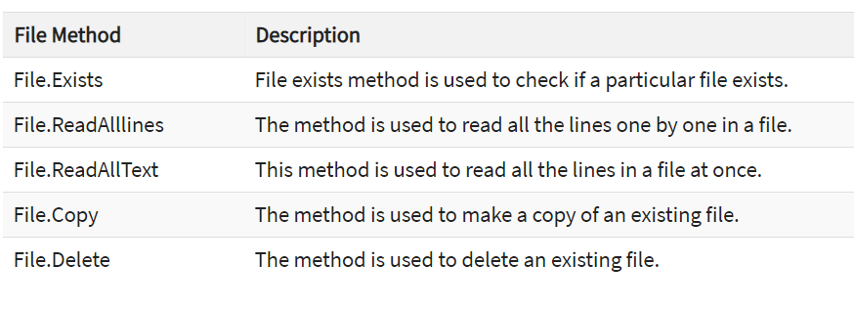
C# has a number of File operations which can be performed on files. Most of these operations are part of the class File.

Slide 4
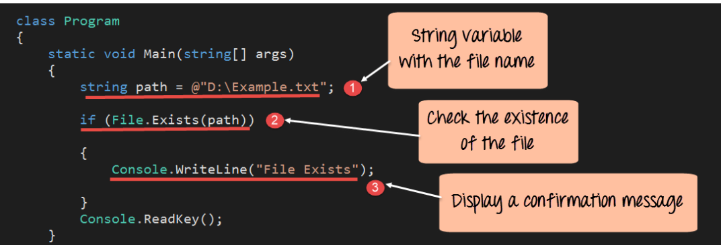
File.Exists
The File exists method is used to check if a particular file exists.

Slide 5
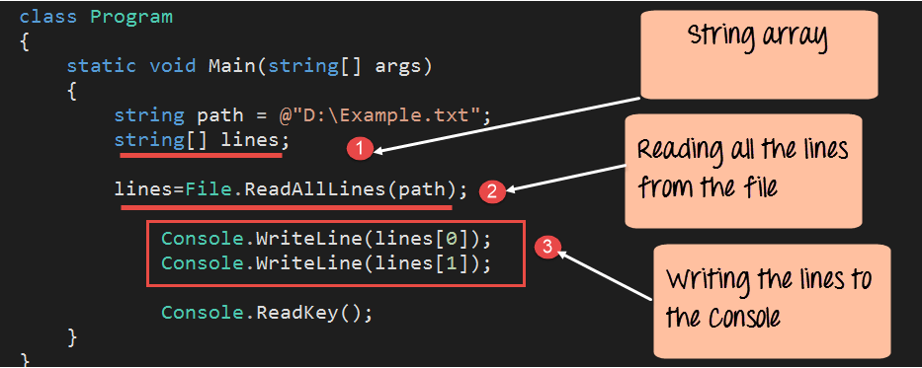
File.ReadAlllines
The method is used to read all the lines one by one in a file. The lines are then stored in a string array variable

Slide 6
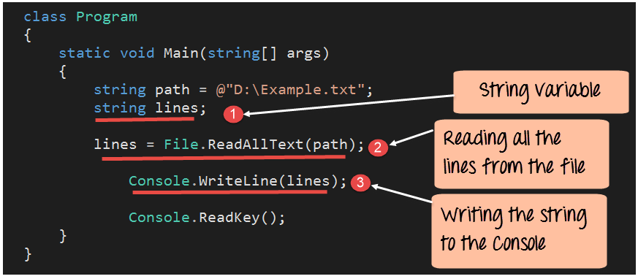
File.ReadAllText
This method is used to read all the lines in a file at once. The lines are then stored in a string variable.
Notes:
Ref : https://www.guru99.com/c-sharp-file-operations.html

Slide 7
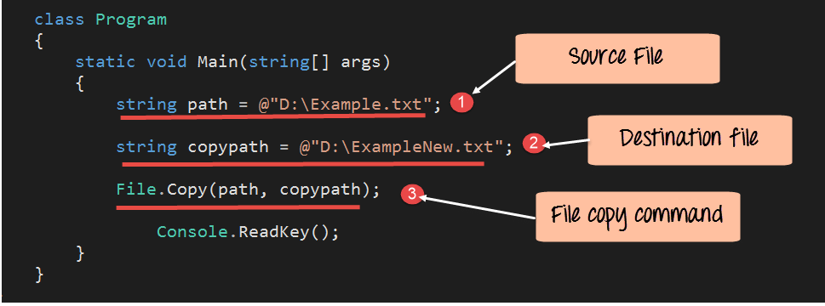
File.Copy
The method is used to make a copy of an existing file.

Slide 8
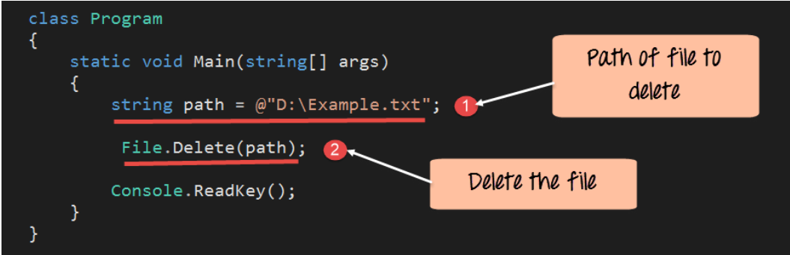
File.Delete
The method is used to delete an existing file.

Slide 9
Streams

Slide 10
C# streams
Stream: System.IO.Stream is an abstract class that provides standard methods to transfer bytes (read, write, etc.) to the source.
It is like a wrapper class to transfer bytes. Classes that need to read/write bytes from a particular source must implement the Stream class.
FileStream reads or writes bytes from/to a physical file whether it is a .txt, .exe, .jpg or any other file. FileStream is derived from the Stream class.

Slide 11
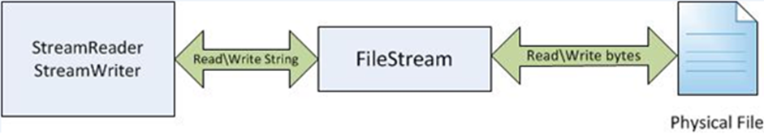
StreamReader and StreamWriter
StreamReader and StreamWriter are found in the System.IO namespace.
Both classes are useful when you want to read or write character based data.
Both of these classes deal with Unicode characters.

Slide 12
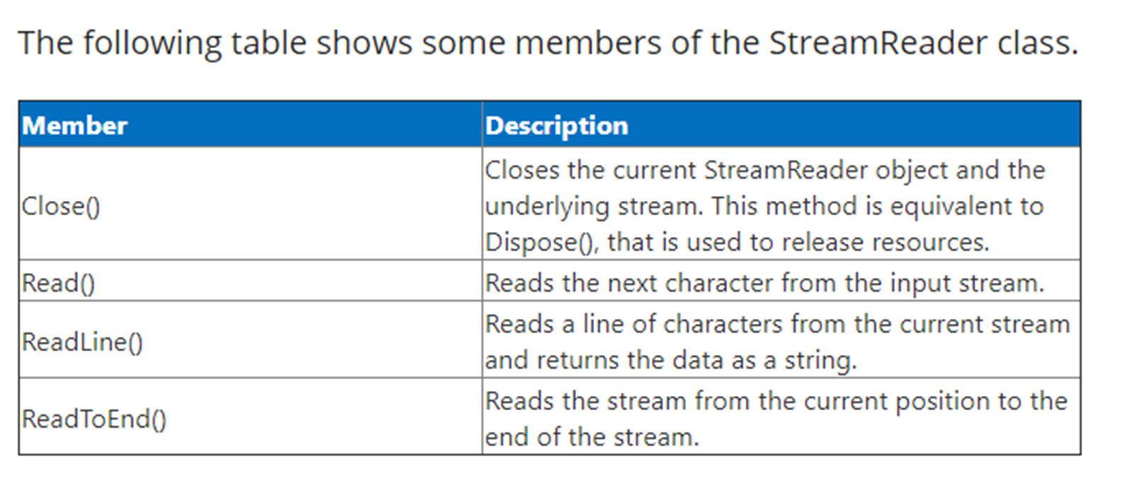
Stream Reader
The stream reader is used to read data from a file using streams.

Slide 13
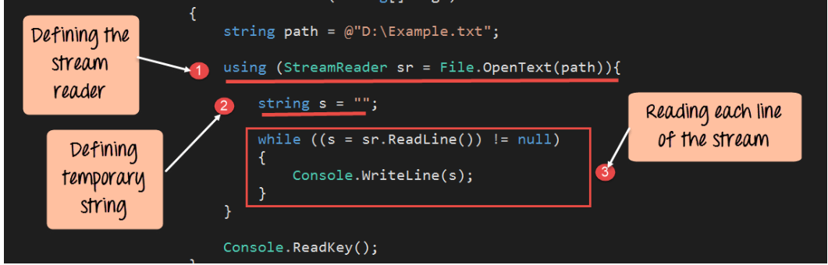
Let's look at an example of how we can use streams for reading data from a file.

Slide 14
Code Explanation
First, we are declaring a stream reader object. The stream reader object is used in C# to define a stream from the file to the application. The data will be pushed from the file to the stream whenever data is read from the file.
The File.OpenText is used to open the file "Example.txt" in read-only mode. The handler to the file is then sent to the stream reader object.
We use the StreamReader type inside a using-statement. This statement allows you to leave the file disposal and opening routines to the C# compiler's knowledge of scope.

Slide 15
Code Explanation
Next, we are defining a temporary variable 's' which will be used to read all the data from the file.
We then use the stream reader method ReadLine to read each line from the stream buffer. When we perform this operation, each line will be first transferred from the file to the buffer. Then the string line will be transferred from the buffer to the variable 's'. We then write the contents of the string 's' to the console.

Slide 16
Stream Writer
The stream writer is used to write data to a file using streams.
The data from the application is first written into the stream.
After that the stream writes the data to the file.

Slide 17
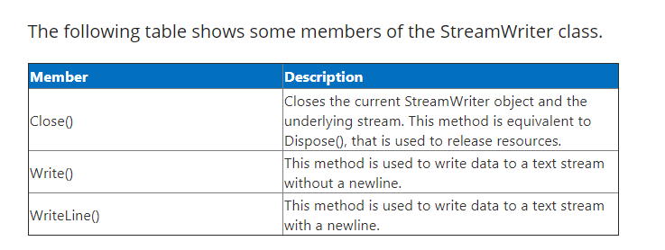

Slide 18
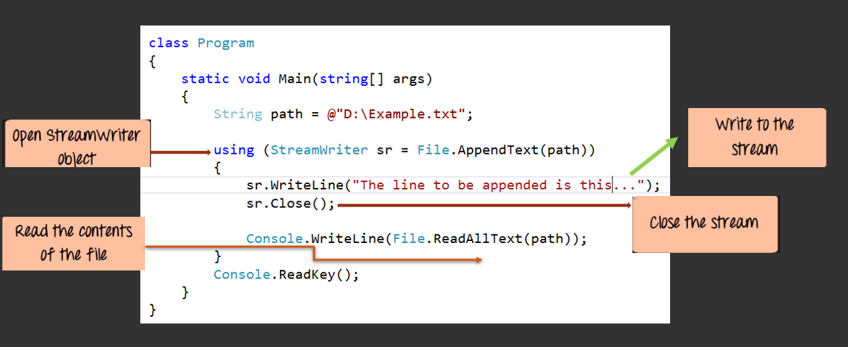
Let's look at an example of how we can use streams for writing data from a file

Slide 19
Code Explanation
First, we are declaring a stream writer object. The stream writer object is used in C# to define a stream. The stream is then used to write data from the application to the file. The data will be pushed from the application to the stream whenever data needs to be written.
The File.AppendText command is used to open the file "Example.txt" in an append mode. The handler to the file is then sent to the stream writer object.
We are using the stream write method Writeline to write the line “The line to be appended is this…" to the stream. From the stream, the line will then be written to the file.

Slide 20
Code Explanation
We then close the stream writer after writing to the file. It's normally a good practice to close file handlers when the file is no longer required for writing purposes.
Finally, we are reading the contents of the file again and writing it to the console log. This is to check as to whether the line was written to the file.

Slide 21
Serialization & Deserialization

Slide 22
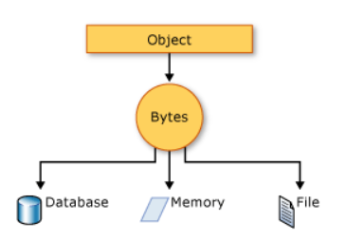
What is Serialization?
Serialization is the process of bringing an object into a form that it can be written on stream.
It's the process of converting the object into a form so that it can be stored on a file, database, or memory; or, it can be transferred across the network.
Its main purpose is to save the state of the object so that it can be recreated when needed.

Slide 23
What is Deserialization?
As the name suggests, deserialization is the reverse process of serialization.
It is the process of getting back the serialized object so that it can be loaded into memory.
It resurrects the state of the object by setting properties, fields etc.

Slide 24
Serialization & Deserialization
Let' say we have a C# class called Tutorial. And the class has 2 properties ----ID and Tutorial’s name.
Serializing can be used to directly write the data properties of the Tutorial class to a file. Deserialization is used to read the data from the file and construct the Tutorial object again.
Let's look at an example of how we can achieve this.

Slide 25
Serialization & Deserialization
Create a class called Tutorial which has 2 properties, namely ID, and Name
We will then create an object from the class and assign a value of "1" to the ID property and a value of ".Net" to the name property.
We will then use serialization to serialize the above object to a file called Example.txt
Finally, we will use deserialization to deserialize the object from the file and display the values in the Console.

Slide 26
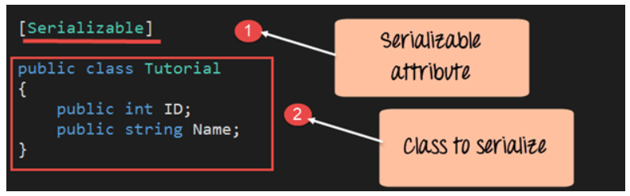
Step 1: Create a class called Tutorial which has 2 properties, namely ID, and Name

Slide 27
Code Explanation
The class which needs to be serialized needs to have the [Serializable] attribute. This is a keyword in C#. This keyword is then attached to the Tutorial class. If you don't mention this attribute, you will get an error when you try to serialize the class.
Next is the definition of the class which will be serialized. Here we are defining a class called "Tutorial" and providing 2 properties, one is "ID" and the other is "Name."

Slide 28
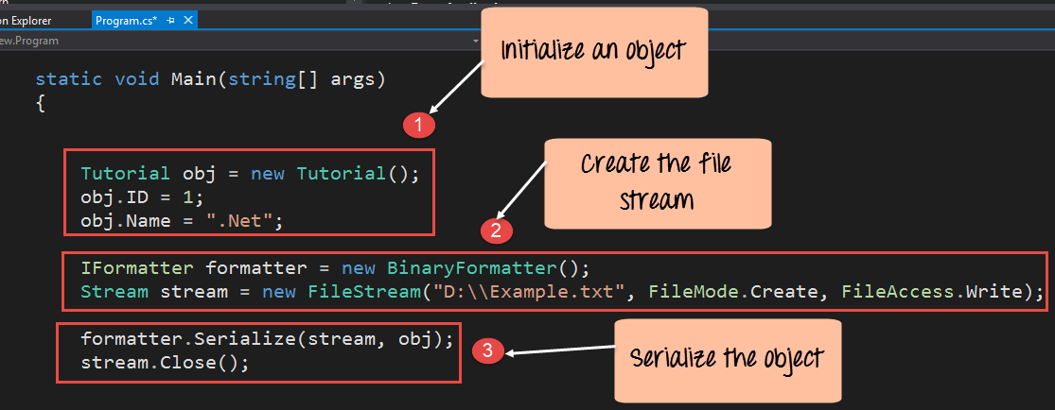
Step 2) In this step, first we will create the object of the Tutorial class and serialize it to the file called Example.txt

Slide 29
Code Explanation:-
First, we create an object of the Tutorial class. We then assign the value of "1" to ID and ".net" to the name property.
We then use the formatter class which is used to serialize or convert the object to a binary format. The data in the file in serialization is written in binary format.
Next, we create a file stream object. The file stream object is used to open the file Example.txt for writing purposes. The keywords FileMode.Create and FileMode.Write is used to specifically mention that the file should be created if it does not exist and be opened for writing purposes.
Finally, we use the Serialize method to transfer the binary data to the file. We then close the stream, since the write operation is complete.

Slide 30
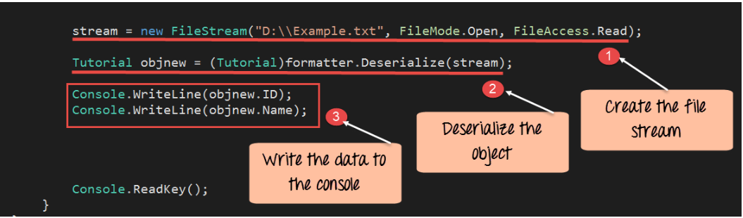
Step 3) Finally to ensure that the data is present in the file, we use deserialization to deserialize the object from the file.

Slide 31
Code Explanation:-
We create the object "stream" to open the file Example.txt in reading only mode.
We then use the formatter class which is used to deserialize the object, which is stored in the Example.txt file. The object returned is set to the object objnew.
Finally, we display the properties of the object "objnew" to the console using the "ID" and "name" properties.

Slide 32
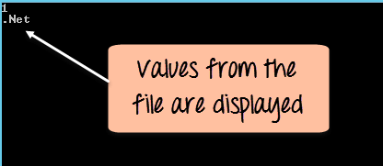
When the above code is set, and the project is run using Visual Studio, you will get the below output.
Output:-
You can see from the above output that the values from the file were deserialized properly and displayed in the console.
Notes:
https://www.guru99.com/c-sharp-file-operations.html

